Slide 1
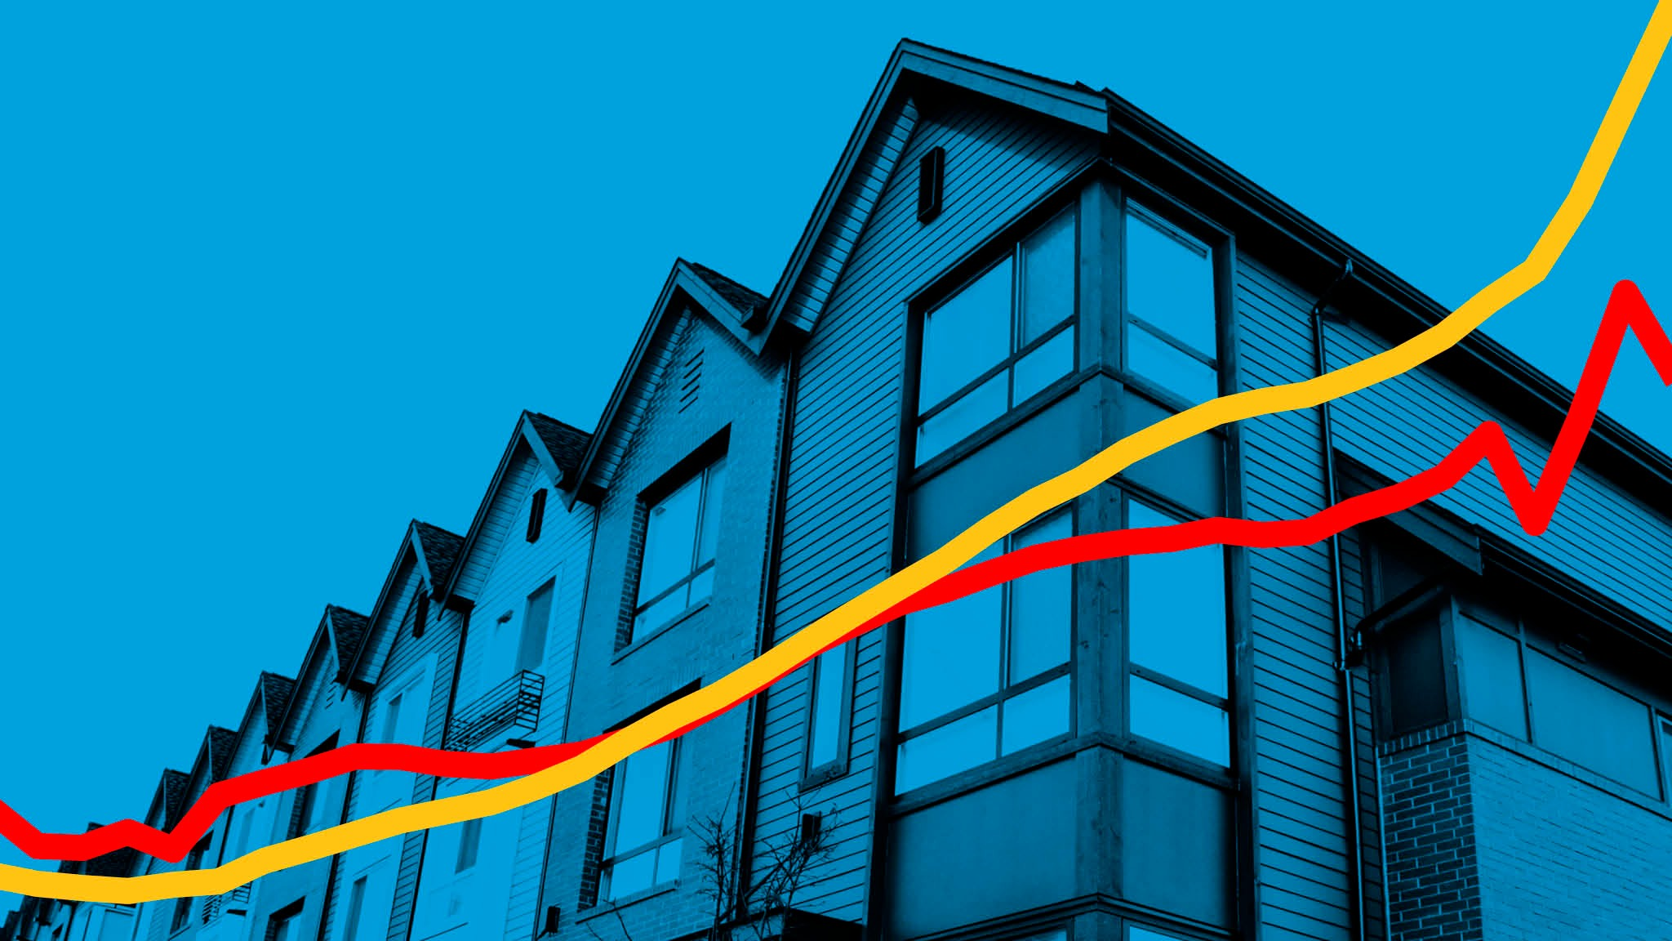
Birmingham Housing price prediction model
Sarah aray
Makaran muhidin
Simon stevens
Nawaz khan
Notes:
SARAH

Slide 2

Background
Create a Machine Learning Model that can predict House Prices in the city of Birmingham, UK.
Based on specific features about the area and the houses in general.
Notes:
SARAH Based on data gathered from the UK's Government Website, the Department for Levelling Up, Housing & Communities API, The Transport for West Midlands API, and The Police API. We wanted to create a Machine Learning Model that is able to predict House Prices in the city of Birmingham, UK; based on certain features, such as crime rate, housing features, schools around the area, and easy access to transportation.

Slide 3





About the Data
Notes:
SARAHThe data was gathered from the UK's Government Website, the Department for Levelling Up, Housing & Communities API, The Transport for West Midlands API, and The Police API.

Slide 4



Data Collection and Feature Engineering
We used Jupyter Notebook and Pandas to call different APIs, and create a data set that was suitable for the model. Taking into consideration the feautures we found the most relevant:
Crime Rates
Transportation
Post Code
Schools in the area
Notes:
SARAH

Slide 5
DATA SETS
School location Data
Ofstead
Data
House pricing Data
Crime rate Data
Bus Route Data
Combined Data
ETL phase and linkage of datasets
Notes:
NAWAZ

Slide 6
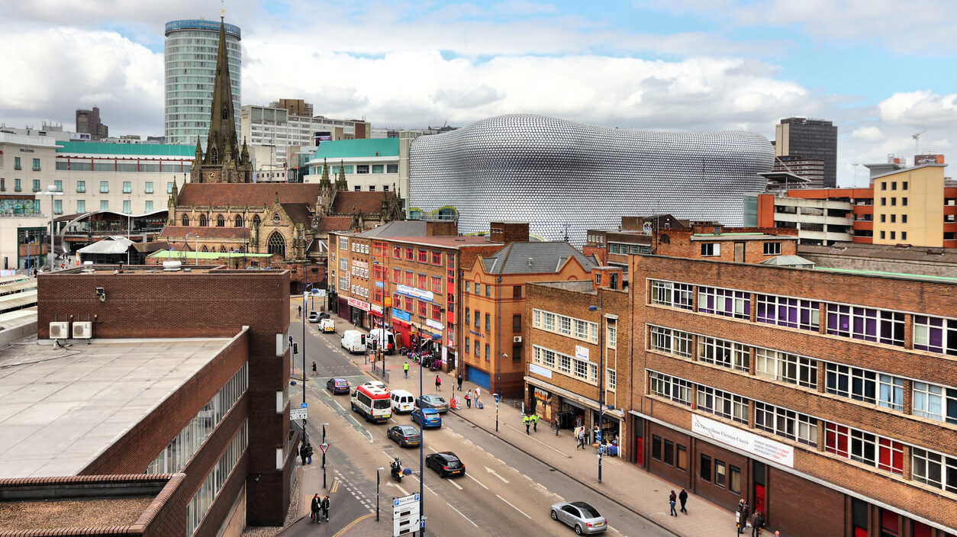
Postcode as a feature
When deciding on location being a feature for our model, we considered ‘postcode selection’ or address-based discrimination.
So, for ethical and accuracy reasons, we dropped postcode from our features.
Other examples of it being used wrongly is in data for employment, schooling or policing, where it can also be discriminatory.
Notes:
SARAH

Slide 7
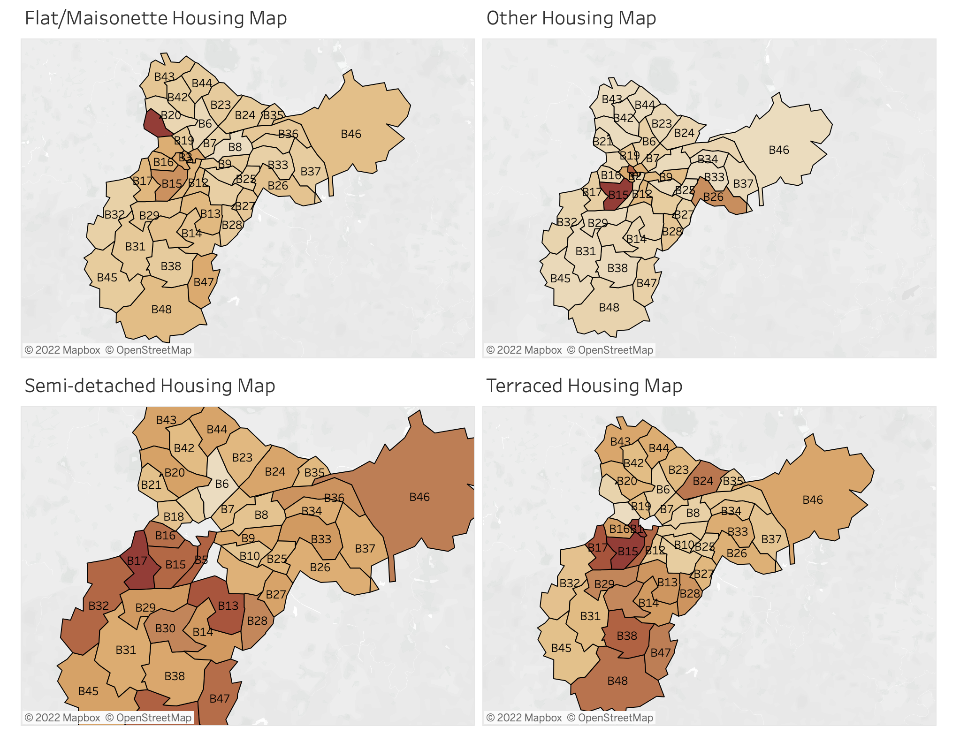
Data Visualisation using Tableau
https://public.tableau.com/shared/85JZW3QTT?:display_count=n&:origin=viz_share_link
Notes:
SARAH

Slide 8

Software and Libraries Used
This project uses the following software and Python libraries:
Python
NumPy
pandas
scikit-learn
Notes:
SARAH

Slide 9



Machine Learning Models
Random Forest Classifier
a classification algorithm consisting of many decisions trees.
Logistic Regression
It estimates probabilities using a logistic regression equation.
Ideal for when the variable being predicted for is a probability on a binary range from 0 to 1.
Ideal for data sets with more complexity and randomness
Notes:
MAKARAN

Slide 10

Machine Learning Models
Linear Regression Analysis
Is used to predict the value of a variable based on the value of another variable.
The variable you are using to predict the other variable's value is called the(features) independent variable.
The variable you want to predict is called the (price) dependent variable.
Notes:
MAKARAN

Slide 11

Hypothesis and Predictions
Random forest tends to be the ideal candidate for estimating datasets that are more longitudinal in nature with more complexity and randomness, and usually scaling and preprocessing the data does not affect its results, so our guess is it will perform better in this case.
Notes:
SIMON

Slide 12
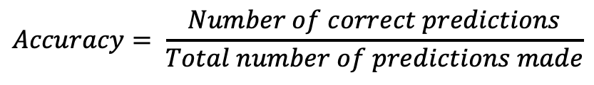
Use of accuracy as a measure
There are various metrics to evaluate an algorith in ML:
Classification Accuracy
Logarithmic Loss
Confusion Matrix
Area under Curve
F1 Score
Mean Absolute Error
Mean Squared Error
We used classification accuracy in our case as we have equal number of samples belonging to each class.
If samples were disproportional, it could give a false sense of achieving high accuracy.
$$Accuracy= \frac{Number of correct predictions}{Total number of predictions made}$$
Notes:
SARAH Accuracy is the ratio of number of correct predictions to the total number of input samples.

Slide 13
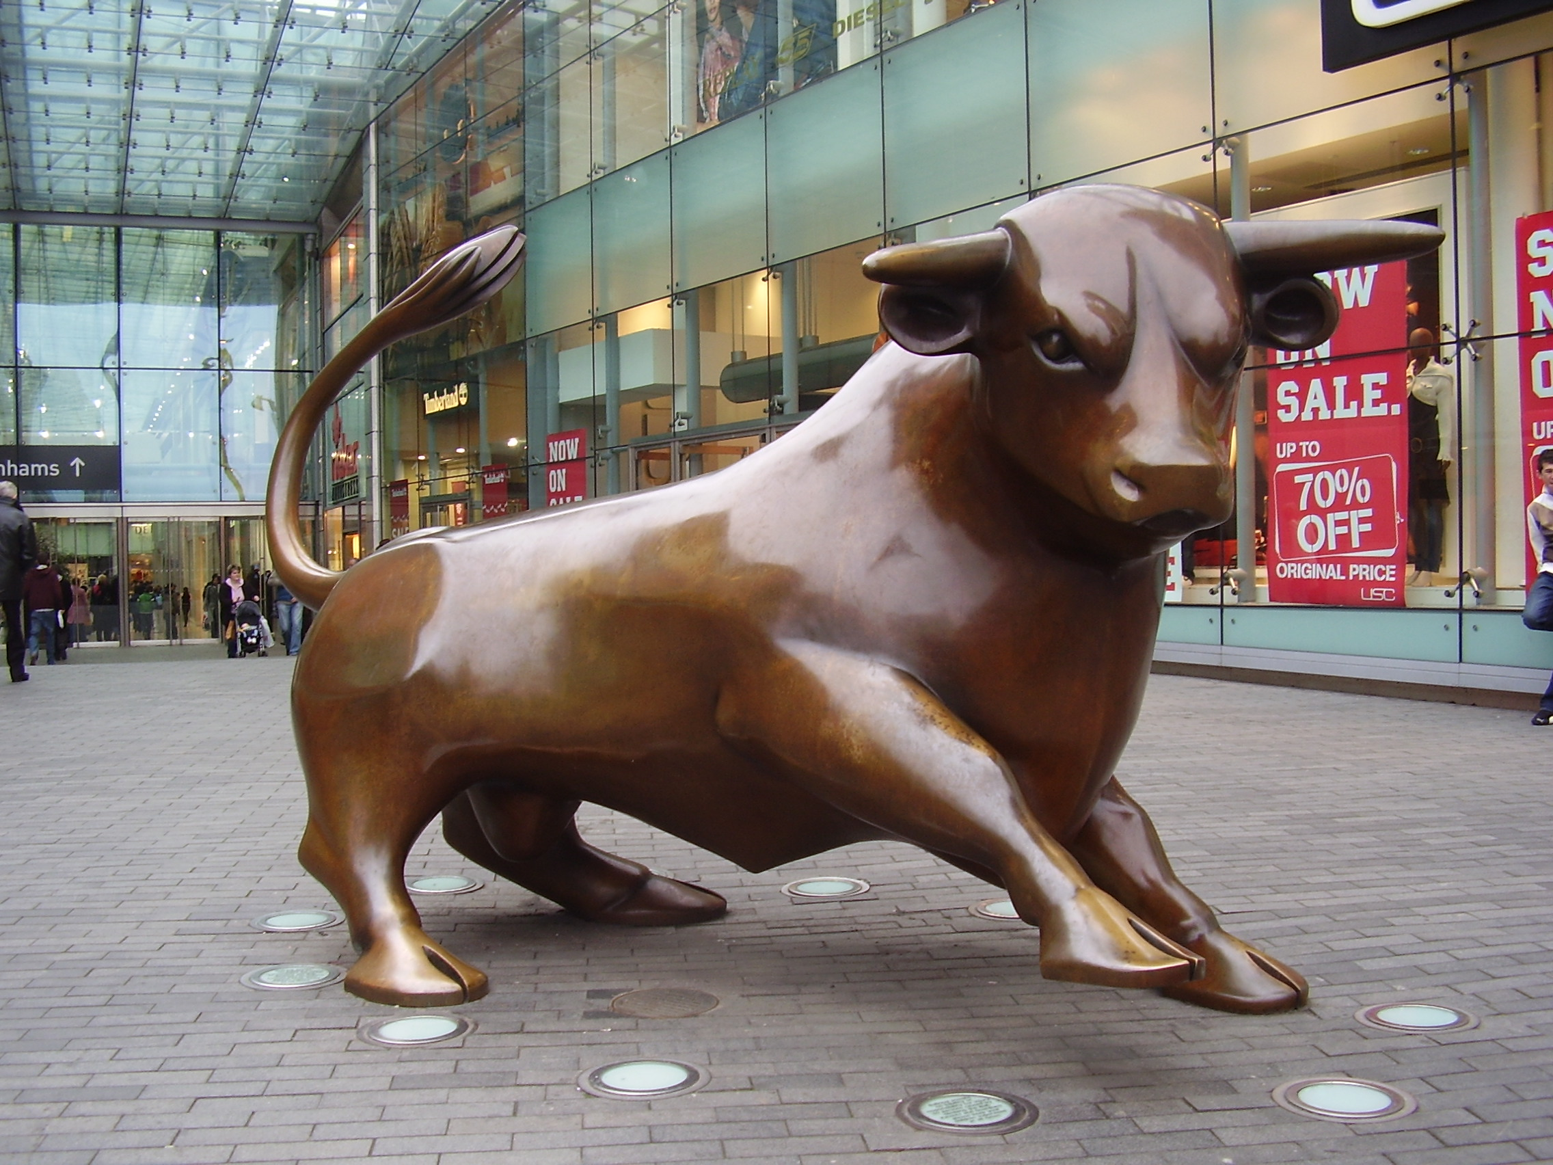
FINAL SCORES
LOGISTIC REGRESSION
Train: 43%
RANDOM FOREST CLASSIFIER
Train: 50%
Test: 42%
Test: 35%
Notes:
MAKARAN

Slide 14

Conclusion
Unlike our hypothesis suggested, Logistic Regression perfomed better than RFC.
The results were affected by us dropping the postcode column.
However, they were unaffected by scaling.
We did not produce feature optimisation, so further features could be added.
The model runs well, but accuracy levels could be improved.
Notes:
NAWAZ

Slide 15



Further Considerations
Do you think your model is sufficiently able to capture all the advanced factors that can affect house prices in any area?
No, we could investigate a larger data set, update, looking further back to establish trends, have greater weighing/severity of Features (e.g severity of crime not just rate).
As well as delve into a data set that incorporates house features i.e Rooms, size, garage
What is the most critical parameter you think to decide the price of any house?
For this model specifically, we focused mostly on location, which is a parameter that could be relevant in various areas not only Birmingham.
Notes:
SIMON

Slide 16
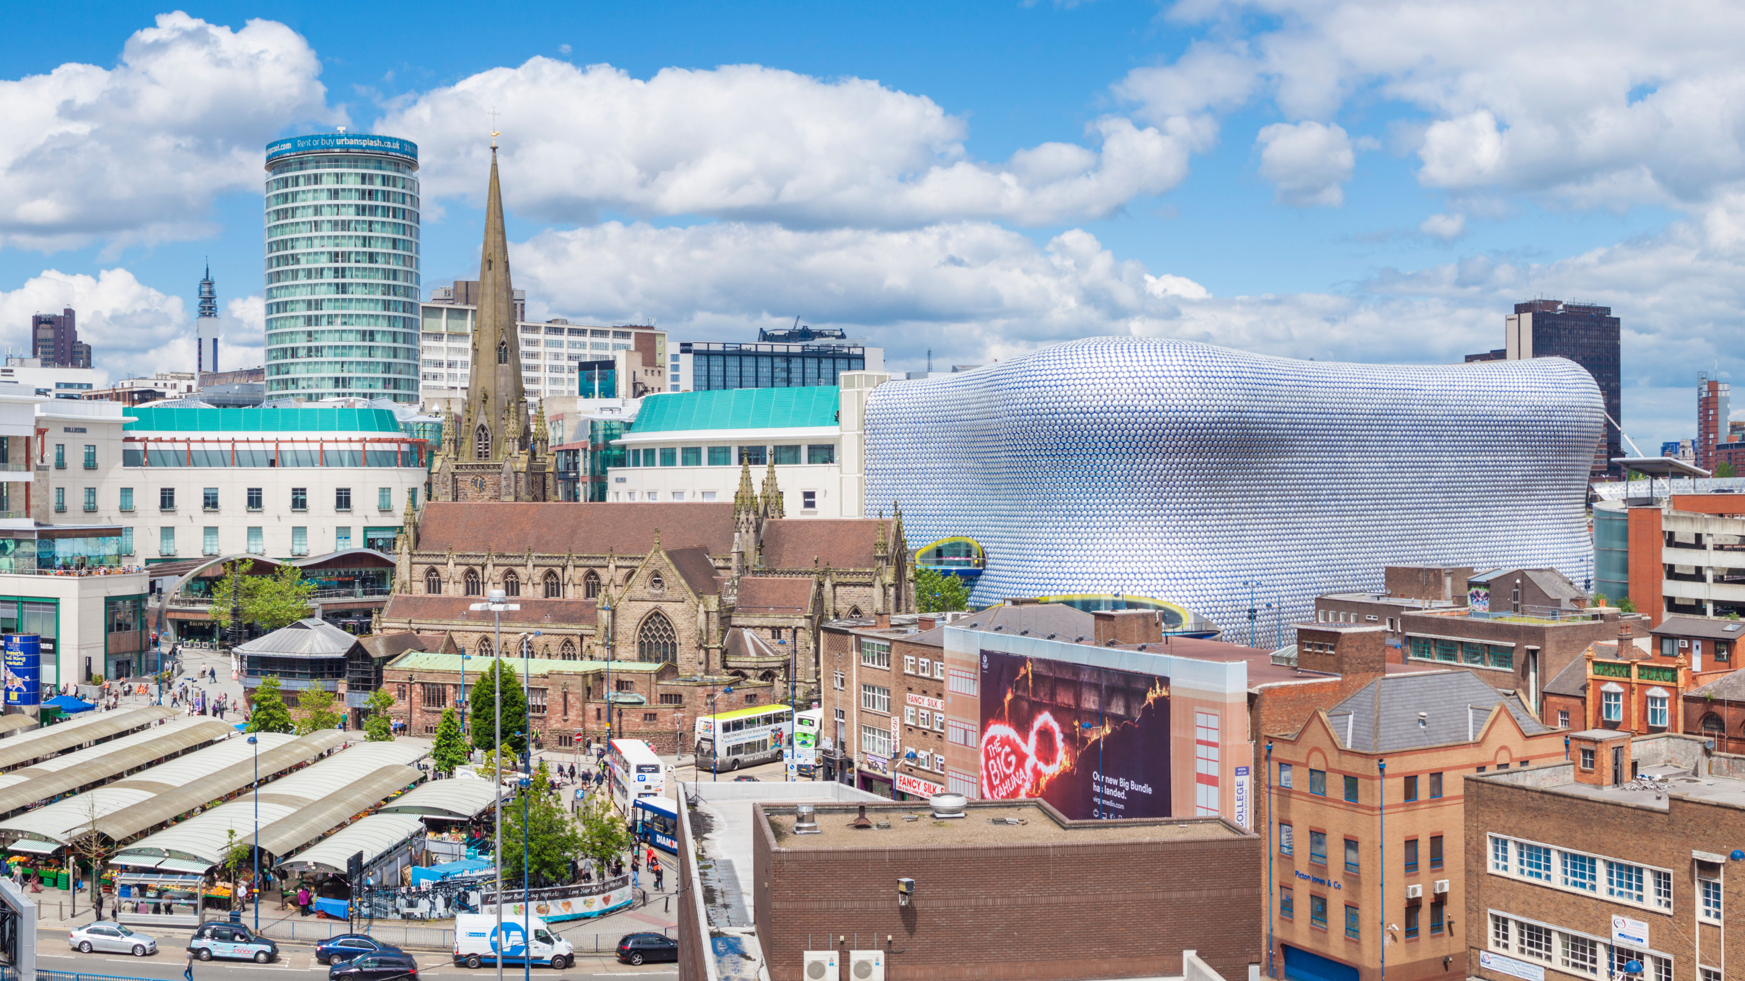


Further Considerations
Why do we need Machine Learning models to solve the problem of house price prediction?
Machine learning will help us using algorithms to best predict prices of houses from a vast amount of data. Taking into considerations trends and as many factors as possible.
What are the factors that affect house prices?
Location and proximity to the city centre.
But also housing features, such as types of house, the number of rooms, heating, windows, etc.
Notes:
SIMON

Slide 17
Any Questions?
https://github.com/saraharayr/housing-price-predictor.git

